Slide 1

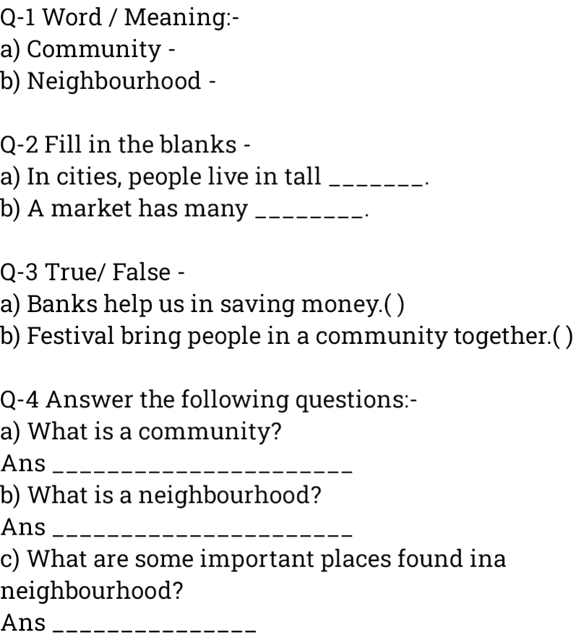
D.V.S PUBLIC SCHOOL
( Recognized & Affiliated to CBSE)
ASSIGNMENT-1
CLASS-- 4-
SUBJECT - EVS-
NAME OF STUDENT:
ROLL NO ________

